Slide 1


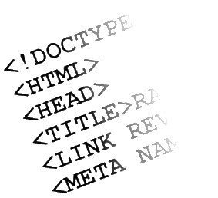

Web Front-end Track Introduction
Track Overview
Web Front-end Track
Telerik Software Academy
http://academy.telerik.com

Slide 2


Table of Contents
Track Objectives & Program
Introduction
Courses program
Trainers Team
Recommended Books and Resources

Slide 3

Web Front-end Track: Objectives & Program
What Topics Shall We Cover?

Slide 4
About the Track
Web front-end track objectives
Provide concepts, technologies and skills for web front-end development
HTML, CSS and JavaScript
Teach the basics of creating user interface
Ending with creating of web applications entirely with JavaScript, HTML and CSS
More info:
telerikacademy.com/…/front-end-developer-2015

Slide 5
Web Front-end Track
Introduction

Slide 6
Web Front-end Track Introduction
The web front-end track aims at covering the needed skills for development of the front-end of web applications
No C#, Java or other programming language is needed
JavaScript will be covered during the courses
New students will join the Academy
With the option to join the Front-end track
And only the front-end track

Slide 7
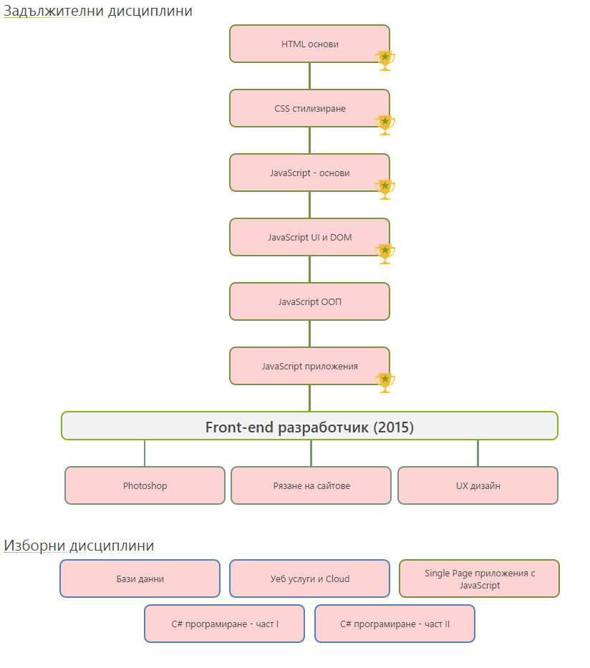
Web Front-end Courses

Slide 8
Web Front-end Courses
The admission for the track will be after JS Fundamentals

Slide 9
Web Front-end Courses
The admission for the track will be after JS Fundamentals
Students in the front-end track cannot apply for Mobile, Web or QA

Slide 10

Track Curriculum

Slide 11



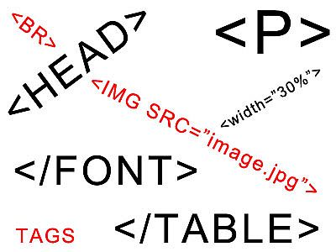

HTML Basics
Web Design Concepts
Tools for HTML, CSS and JS
Introduction to HTML
HTML Tables
HTML Forms
Semantic HTML
HTML Basics Test

Slide 12
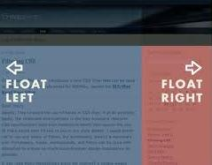




CSS Styling
CSS Basics
CSS Presentation
CSS Positioning
CSS Preprocessors
Exam Preparation
CSS Styling Exam

Slide 13



JavaScript Fundamentals
Intro to JavaScript development
Data Types and Variables
Operators and Expressions
Conditional Statements
Loops and Arrays
Functions
Exam Preparation
JavaScript Practical Exam

Slide 14
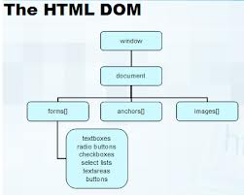
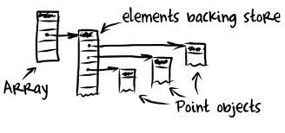
JavaScript UI
Document Object Model
DOM Manipulation
DOM Operations
JavaScript Events
jQuery Overview
Templates
Canvas API
SVG API
Exam Preparation
JavaScript Practical Exam

Slide 15


JavaScript OOP
Using Objects
Advanced Functions
JavaScript OOP
Inheritance
JavaScript Patterns
Exceptions
Good Practices
Exam Preparation
JavaScript Practical Exam

Slide 16

JavaScript Applications
Web Storages
Promises and Async Programming
HTTP and AJAX
Consuming Remote Data
Third-party APIs – Facebook, Google, etc…
JavaScript Design Patterns and SPA
Business Clouds
Exam Preparation
JavaScript Practical Exam

Slide 17
Photoshop for Front-ends
A brief course, covering the fundamentals skills needed for:
Slicing a PSD design
Adapting PSD design
Using Photoshop for the needs of Front-end development
Practical Exam

Slide 18
Slice and Dice
Responsive Design
Twitter Bootstrap
Support of older browsers
Importing Facebook, Google in our web sites
Slice and Dice
Cookies, Caching, Sprites, Minifying
etc…
Practical Exam

Slide 19
UX Design
A brief course, covering the fundamentals of UX design
Introduction user-experience
User interface fundamentals
Creating usable wireframes
Fundamentals of graphical design
Creating a design for a web application
Examination

Slide 20
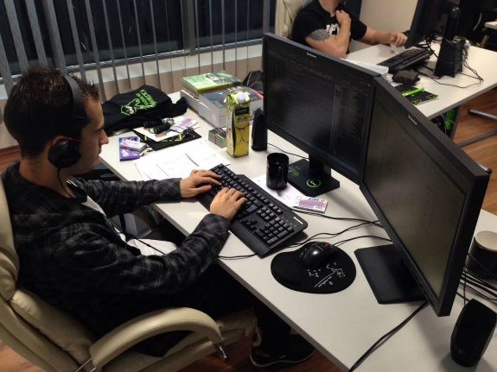
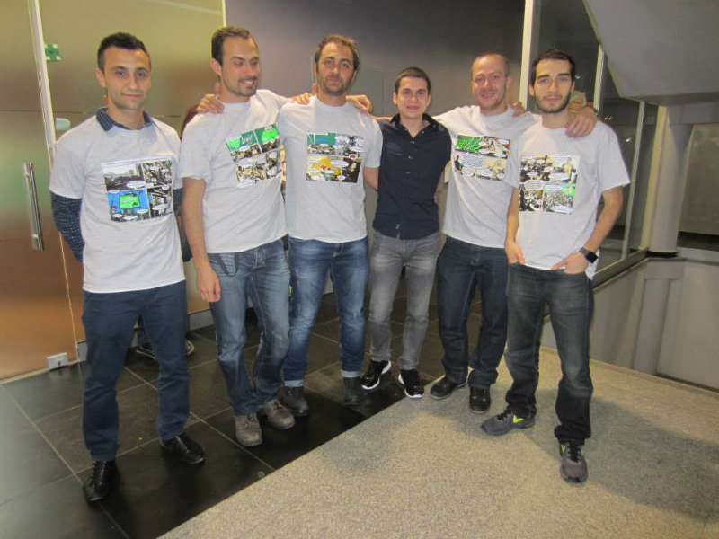
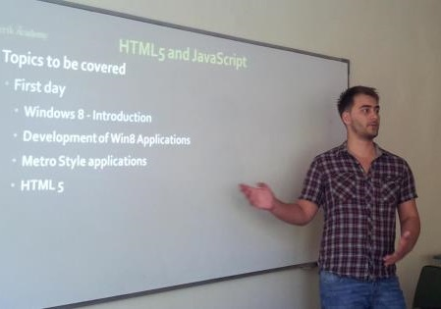
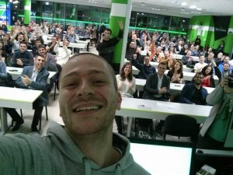
Trainers Team

Slide 21

Trainers Team
Nikolay Kostov
Manager Software Engineering @ Telerik (Progress)
Microsoft Certified Trainer (MCT)
Champion from Telerik Academy
IT and Informatics competitions winner
Student in Sofia University (Computer Science)
Email: nikolay.kostov [at] telerik.com
Blog: http://nikolay.it
GitHub: https://github.com/NikolayIT

Slide 22
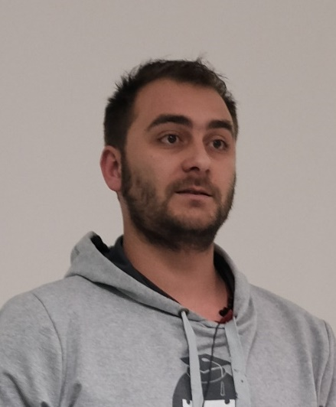
Trainers Team (2)
Doncho Minkov
Senior Technical Trainer @ Telerik Software Academy
Contestant in the Informatics competitions
Champion from Telerik Software Academy
Experience with Web and Mobile apps
Proficient with JavaScript and .NET
Email: doncho.minkov [at] telerik.com
Blog: http://minkov.it

Slide 23
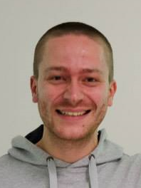
Trainers Team (3)
Ivaylo Kenov
Technical Trainer @ Telerik Academy
Mathematical competitions contestant
Champion from Telerik Software Academy
E-mail: ivaylo.kenov [at] telerik.com
Champion in OOP and DSA
Blog: http://ivaylo.bgcoder.com/
GitHub: https://github.com/ivaylokenov

Slide 24

Trainers Team (4)
Evlogi Hristov
Technical Trainer @ Telerik Software Academy
Graduate from the fourth season of Telerik Software Academy
Ex-developer, Sharepoint
E-mail: evlogi.hristov [at] telerik.com

Slide 25

Recommended Books

Slide 26




Recommended Books
“Designing with Web Standards”, Jeffrey Zeldman, New Riders Press, 2005, ISBN 9780321616951
"HTML & XHTML: The Definitive Guide, Sixth Edition", Chuck Musciano, Bill Kennedy, O'Reilly, 2006, ISBN 9780596527327
"CSS: The Definitive Guide, Third Edition", Eric Meyer, O'Reilly, 2006, ISBN 9780596527334
“PPK on JavaScript”, Peter Paul-Koch, New Riders Press, 2006, ISBN 9780321423306

Slide 27

Track Web Site & Forums
Register for the "Telerik Academy Forums":
Discuss the course exercises with your colleagues
Find solutions for the exercises
Share source code / discuss ideas
The HTML Basics official web site:
http://telerikacademy.com/Forum/Category/2/front-end-development
http://academy.telerik.com/student-courses/web-design-and-ui/about

Slide 28
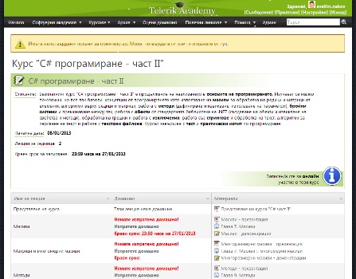
Telerik Integrated Learning System (TILS)
The Telerik Integrated Learning System (TILS)
www.telerikacademy.com
Important resource for all students
Homework submissions
Homework peer reviews
Presence cards with barcode
Reports about your results
telerikacademy.com/…/front-end-developer-2015

Slide 29
Required Software
Software needed for this course:
Sublime Text 2/3
Notepad++
Jetbrains WebStorm
Aptana Studio
Atom
Microsoft Visual Studio 2013
Visual Studio Community 2013 (free version of VS 2013)
Any text editor that is convenient with you

Slide 30
Web Front-end Track
http://academy.telerik.com

Slide 31



Free Trainings @ Telerik Academy
"Web Design with HTML5, CSS3 and JavaScript" course @ Telerik Academy
html5course.telerik.com
Telerik Software Academy
academy.telerik.com
Telerik Academy @ Facebook
facebook.com/TelerikAcademy
Telerik Software Academy Forums
forums.academy.telerik.com

